Slide 1
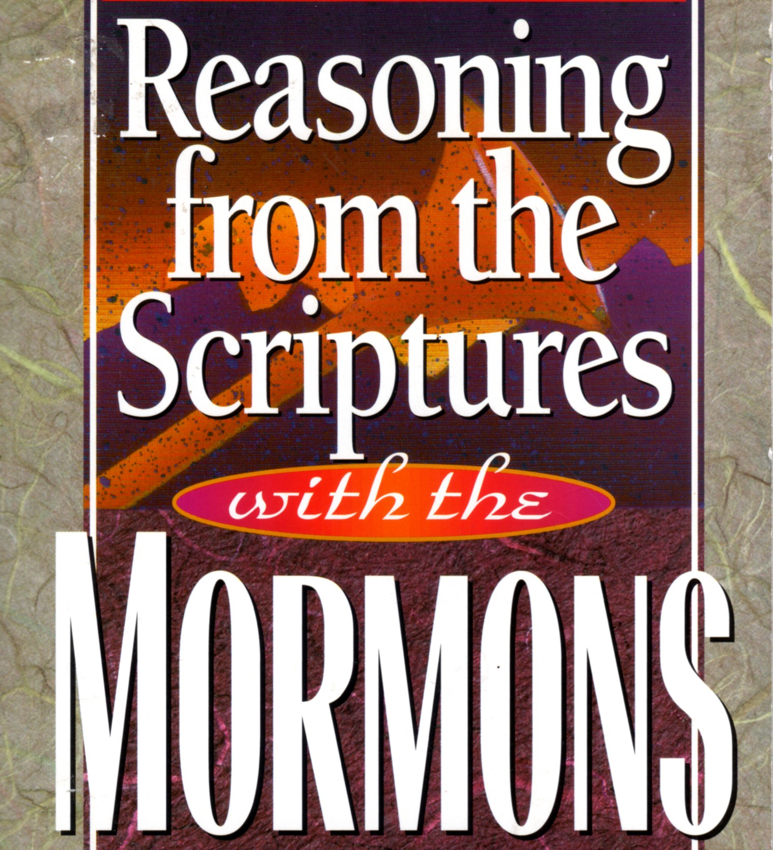

Slide 2
Full-scale model of the Golden Plates based on Joseph Smith's description

Slide 3
“I told the brethren that the Book of Mormon was the most correct of any book on earth, and the keystone of our religion, and a man would get nearer to God by abiding by its precepts, than any other book.”
Joseph Smith, from History of the Church of Jesus Christ of Latter-day Saints (1973).

Slide 4
The Book of Mormon is a volume of holy scripture comparable to the Bible. It is a record of God’s dealings with the ancient inhabitants of the Americas and contains the fulness of the everlasting gospel.
The book was written by many ancient prophets by the spirit of prophecy and revelation. Their words, written on gold plates, were quoted and abridged by a prophet-historian named Mormon. The record gives an account of two great civilizations. One came from Jerusalem in 600 B.C., and afterward separated into two nations, known as the Nephites and the Lamanites. The other came much earlier when the Lord confounded the tongues at the Tower of Babel. This group is known as the Jaredites. After thousands of years, all were destroyed except the Lamanites, and they are among the ancestors of the American Indians.
From the Introduction in The Book of Mormon.

Slide 5
The crowning event recorded in the Book of Mormon is the personal ministry of the Lord Jesus Christ among the Nephites soon after his resurrection. It puts forth the doctrines of the gospel, outlines the plan of salvation, and tells men what they must do to gain peace in this life and eternal salvation in the life to come.
From the Introduction in The Book of Mormon.

Slide 6
After Mormon completed his writings, he delivered the account to his son Moroni, who added a few words of his own and hid up the plates in the hill Cumorah. On September 21, 1823, the same Moroni, then a glorified, resurrected being, appeared to the Prophet Joseph Smith and instructed him relative to the ancient record and its destined translation into the English language.
From the Introduction in The Book of Mormon.

Slide 7
Deuteronomy 4:2
You shall not add to the word that I command you, nor take from it, that you may keep the commandments of the LORD your God that I command you.
Deuteronomy 12:32
Everything that I command you, you shall be careful to do. You shall not add to it or take from it.
Deuteronomy 18:20
But the prophet who presumes to speak a word in my name that I have not commanded him to speak, or who speaks in the name of other gods, that same prophet shall die.

Slide 8
Revelation 22:18
I warn everyone who hears the words of the prophecy of this book: if anyone adds to them, God will add to him the plagues described in this book

Slide 9
Isaiah 29:1-4
¹ Ah, Ariel, Ariel, the city where David encamped! Add year to year; let the feasts run their round. ² Yet I will distress Ariel, and there shall be moaning and lamentation, and she shall be to me like an Ariel.^{[a]} ³ And I will encamp against you all around, and will besiege you with towers and I will raise siegeworks against you. ⁴ And you will be brought low; from the earth you shall speak, and from the dust your speech will be bowed down; your voice shall come from the ground like the voice of a ghost, and from the dust your speech shall whisper.
Footnotes:
a. Ariel could mean lion of God, or hero (2 Samuel 23:20), or altar hearth (Ezekiel 43:15–16)

Slide 10
Isaiah 29:11-12
¹¹ And the vision of all this has become to you like the words of a book that is sealed. When men give it to one who can read, saying, “Read this,” he says, “I cannot, for it is sealed.” ¹² And when they give the book to one who cannot read, saying, “Read this,” he says, “I cannot read.”

Slide 11
I went to the city of New York, and presented the characters which had been translated, with the translation thereof, to Professor Charles Anthon, a gentleman celebrated for his literary attainments. Professor Anthon stated that the translation was correct, more so than any he had before seen translated from the Egyptian. I then showed him those which were not yet translated, and he said that they were Egyptian, Chaldaic, Assyriac, and Arabic; and he said they were true characters. He gave me a certificate, certifying to the people of Palmyra that they were true characters, and that the translation of such of them as had been translated was also correct. . . . He asked me how the young man found out that there were gold plates in the place where he found them. I answered that an angel of God had revealed it unto him. He then said to me, 'Let me see that certificate.' . . . When he took it [he] tore it to pieces, saying that there was no such thing now as ministering of angels, and that if I would bring the plates to him he would translate them. I informed him that part of the plates were sealed, and that I was forbidden to bring them. He replied, 'I cannot read a sealed book.'
Testimony of Martin Harris in “Joseph Smith – History”

Slide 12
Ezekiel 37:16-17
¹⁶ Son of man, take a stick and write on it, “For Judah, and the people of Israel associated with him”; then take another stick and write on it, “For Joseph (the stick of Ephraim) and all the house of Israel associated with him.” ¹⁷ And join them one to another into one stick, that they may become one in your hand.

Slide 13
Ezekiel 37:18-28
¹⁸ And when your people say to you, ‘Will you not tell us what you mean by these?’ ¹⁹ say to them, Thus says the Lord GOD: Behold, I am about to take the stick of Joseph (that is in the hand of Ephraim) and the tribes of Israel associated with him. And I will join with it the stick of Judah, and make them one stick, that they may be one in my hand. ²⁰ When the sticks on which you write are in your hand before their eyes, ²¹ then say to them, Thus says the Lord GOD: Behold, I will take the people of Israel from the nations among which they have gone, and will gather them from all around, and bring them to their own land. ²² And I will make them one nation in the land, on the mountains of Israel. And one king shall be king over them all, and they shall be no longer two nations, and no longer divided into two kingdoms. ²³ They shall not defile themselves anymore with their idols and their detestable things, or with any of their transgressions. But I will save them from all the backslidings in which they have sinned, and will cleanse them; and they shall be my people, and I will be their God. ²⁴ “My servant David shall be king over them, and they shall all have one shepherd. They shall walk in my rules and be careful to obey my statutes. ²⁵ They shall dwell in the land that I gave to my servant Jacob, where your fathers lived. They and their children and their children's children shall dwell there forever, and David my servant shall be their prince forever. ²⁶ I will make a covenant of peace with them. It shall be an everlasting covenant with them. And I will set them in their land and multiply them, and will set my sanctuary in their midst forevermore. ²⁷ My dwelling place shall be with them, and I will be their God, and they shall be my people. ²⁸ Then the nations will know that I am the LORD who sanctifies Israel, when my sanctuary is in their midst forevermore.”

Slide 14
I will now give you a description of the manner in which the Book of Mormon was translated. Joseph would put the seer stone into a hat, and put his face in the hat, drawing it closely around his face to exclude the light; and in the darkness the spiritual light would shine. A piece of something resembling parchment would appear, and on that appeared the writing. One character at a time would appear, and under it was the interpretation in English. Thus the Book of Mormon was translated by the gift and power of God, and not by any power of man.
David Whitmer, An Address to All Believers in Christ (1887).

Slide 15
Following the translation of the Book of Mormon, Joseph Smith said he heard a voice from out of a bright light above him that said, “These plates have been revealed by the power of God, and they have been translated by the power of God. The translation of them which you have seen is correct, and I command you to bear record of what you now see and hear.”
Joseph Smith, from History of the Church of Jesus Christ of Latter-day Saints (1973).

Slide 16
Joseph did not render the writing on the Gold plates into the English language in his own style of language as many people believe, but every word and every letter was given to him by the gift and power of God. So it was the work of God and not of Joseph Smith, and it was done in this way... The Lord caused each word spelled as it is in the book to appear on the stones in short sentences of words, and when Joseph had uttered the sentence or word before him the scribe had written it properly, that sentence would disappear and another appear. And if there was a word wrongly written or even a letter incorrect the writing on the stones would remain there. Then Joseph would require the scribe to spell the reading of the last spoken and thus find the mistake and when corrected the sentence would disappear as usual.
Journal of Oliver Huntingon, p168 typed copy at Utah State Historical Society.

Slide 17
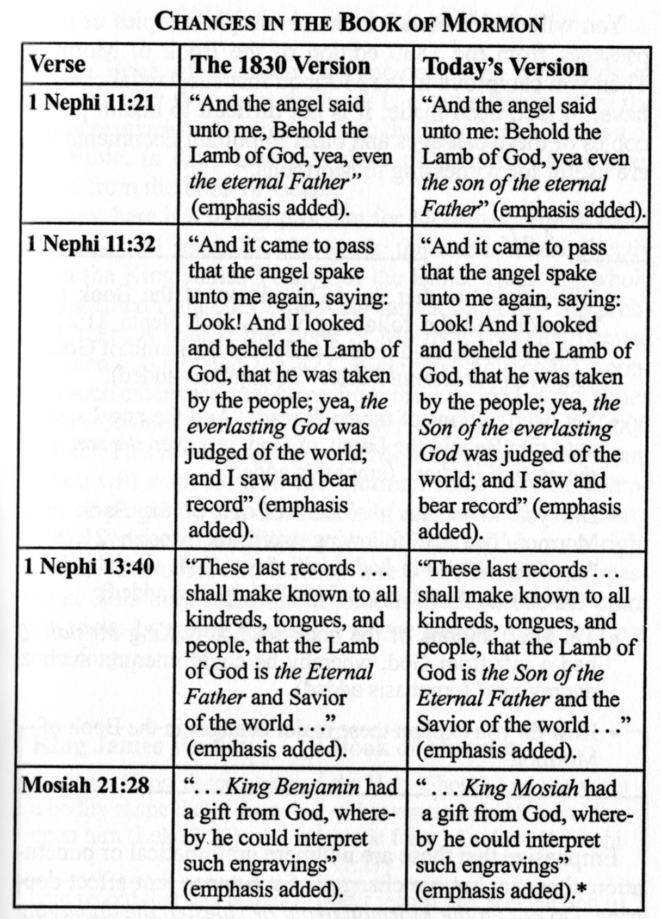

Slide 18
The Book of Mormon mentions nothing about:
Mormon church organization
Aaronic priesthood
“plurality of Gods” doctrine
“God is an exalted man” doctrine
the doctrine that men may become gods
the doctrine of three degrees of glory, or three kingdoms
“plurality of wives” doctrine
“celestial marriage” doctrine with all the elaborate temple ceremonies and oaths
baptism for the dead
“word of wisdom” doctrine
the doctrine of preexistence
the doctrine of eternal progression

Slide 19
“I told the brethren that the Book of Mormon was the most correct of any book on earth, and the keystone of our religion, and a man would get nearer to God by abiding by its precepts, than any other book.”
Joseph Smith, from History of the Church of Jesus Christ of Latter-day Saints (1973).

Slide 20
The Book of Mormon is a volume of holy scripture comparable to the Bible. It is a record of God’s dealings with the ancient inhabitants of the Americas and contains the fulness of the everlasting gospel.
. . .
The crowning event recorded in the Book of Mormon is the personal ministry of the Lord Jesus Christ among the Nephites soon after his resurrection. It puts forth the doctrines of the gospel, outlines the plan of salvation, and tells men what they must do to gain peace in this life and eternal salvation in the life to come.
From the Introduction in The Book of Mormon.

Slide 21
We believe the Bible to be the word of God, as far as it is translated correctly.
“Articles of Faith”, The Church of Jesus Christ of Latter-day Saints (1982).

Slide 22
²⁴ And the angel of the Lord said unto me: Thou hast beheld that the book proceeded forth from the mouth of a Jew; and when it proceeded forth from the mouth of a Jew it contained the fulness of the gospel of the Lord, of whom the twelve apostles bear record; and they bear record according to the truth which is in the Lamb of God.
²⁵ Wherefore, these things go forth from the Jews in purity unto the Gentiles, according to the truth which is in God.
²⁶ And after they go forth by the hand of the twelve apostles of the Lamb, from the Jews unto the Gentiles, thou seest the formation of that great and abominable church, which is most abominable above all other churches; for behold, they have taken away from the gospel of the Lamb many parts which are plain and most precious; and also many covenants of the Lord have they taken away.
²⁷ And all this have they done that they might pervert the right ways of the Lord, that they might blind the eyes and harden the hearts of the children of men.
(Continued on next slide…)

Slide 23
(…continued from previous slide)
²⁸ Wherefore, thou seest that after the book hath gone forth through the hands of the great and abominable church, that there are many plain and precious things taken away from the book, which is the book of the Lamb of God.
²⁹ And after these plain and precious things were taken away it goeth forth unto all the nations of the Gentiles; and after it goeth forth unto all the nations of the Gentiles, yea, even across the many waters which thou hast seen with the Gentiles which have gone forth out of captivity, thou seest—because of the many plain and precious things which have been taken out of the book, which were plain unto the understanding of the children of men, according to the plainness which is in the Lamb of God—because of these things which are taken away out of the gospel of the Lamb, an exceedingly great many do stumble, yea, insomuch that Satan hath great power over them.
I Nephi 13:24-29, Book of Mormon

Slide 24
That is telling us that soon after the New Testament was written there were persons among the Gentiles who systematically, with wicked motives and evil intent, removed portions of the sacred word, and took from the Bible much very important doctrinal information. . . . In order to do this effectively two things were necessary: (1) It had to be done early, before there were multiple copies of the various books; and (2) It had to be accomplished by someone near the source who had access to the originals or earliest copies. . . . In others words, the process began early, by the end of the first century, and continued into the second and third centuries after Christ.
Robert J. Matthews, “What the Book of Mormon Tells Us About the Bible.” BYU, 26 October, 1991

Slide 25
Many insertions were made, some of them “slanted” for selfish purposes, while at times deliberate falsifications and fabrications were perpetrated.
The Bible as we know it is a different volume from what it was – and would have been – had it not been changed so much by those with selfish interests.
Mormon apostle Mark E. Petersen

Slide 26
… no one shall be appointed to receive commandments and revelations in this church excepting my servant Joseph Smith, Junior …
D&C 28:2b
…thou shalt take thy brother, Hiram Page, between him and thee alone, and tell him that those things which he hath written from that stone are not of me and that Satan deceiveth him …
D&C 28:11b

Slide 27
The Hebrew and Greek manuscripts of the Bible from which translations have been made, are evidently very much corrupted…. The learned are under the necessity of translating from such mutilated, imperfect, and, in very many instances, contradictory copies as still exist. This uncertainty, combined with the imperfections of uninspired translators, renders the Bibles of all languages, at the present day, emphatically the words of men, instead of the pure word of God.
Who, in his right mind, could, for one moment, suppose the Bible in its present form to be a perfect guide? Who knows that even one verse of the Bible has escaped pollution?
Mormon apostle Orson Pratt

Slide 28
Many important concepts once in the Bible but now missing from it have been restored through the Book of Mormon and other Later-day revelations.
Robert J. Matthews, “A Sure Foundation.” Deseret, 1988

Slide 29
…many have undertaken to compile a narrative of the things that have been accomplished among us…
Luke 1:1
…Is this not written in the Book of Jashar?…
Joshua10:13
…behold, it is written in the Book of Jashar….
2 Samuel 1:18
Therefore it is said in the Book of the Wars of the LORD….
Numbers 21:14

Slide 30
And that seer will I bless, and they that seek to destroy him shall be confounded; for this promise I give unto you; for I will remember you from generation to generation; and his name shall be called Joseph, and it shall be after the name of his father; and he shall be like unto you; for the thing which the Lord shall bring forth by his hand shall bring my people unto salvation.
Genesis 50:33, Joseph Smith Inspired Version of the Bible

Slide 31
For truly, I say to you, until heaven and earth pass away, not an iota, not a dot, will pass from the Law until all is accomplished.
Matthew 5:18

